Slide 1

STOCHASTIC METHODS
5.0 Introduction
5.1 The Elements of Counting
5.2 Elements of Probability Theory
5.3 Applications of the Stochastic Methodology
5.4 Bayes’ Theorem

Slide 2
Diagnostic Reasoning. In medical diagnosis, for example, there is not always an obvious cause/effect relationship between the set of symptoms presented by the patient and the causes of these symptoms. In fact, the same sets of symptoms often suggest multiple possible causes.
Natural language understanding. If a computer is to understand and use a human language, that computer must be able to characterize how humans themselves use that language. Words, expressions, and metaphors are learned, but also change and evolve as they are used over time.
Planning and scheduling. When an agent forms a plan, for example, a vacation trip by automobile, it is often the case that no deterministic sequence of operations is guaranteed to succeed. What happens if the car breaks down, if the car ferry is cancelled on a specific day, if a hotel is fully booked, even though a reservation was made?
Learning. The three previous areas mentioned for stochastic technology can also be seen as domains for automated learning. An important component of many stochastic systems is that they have the ability to sample situations and learn over time.

Slide 3
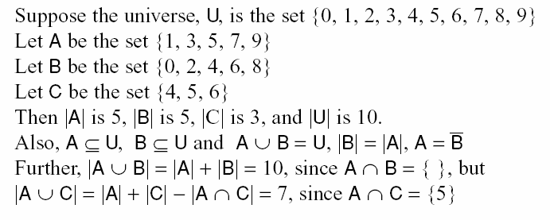

Slide 4

The Addition rule for combining two sets:
The Addition rule for combining three sets:
This Addition rule may be generalized to any finite number of sets

Slide 5


The Cartesian Product of two sets A and B
The multiplication principle of counting, for two sets

Slide 6

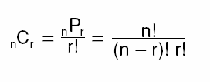
The permutations of a set of n elements taken r at a time
The combinations of a set of n elements taken r at a time

Slide 7
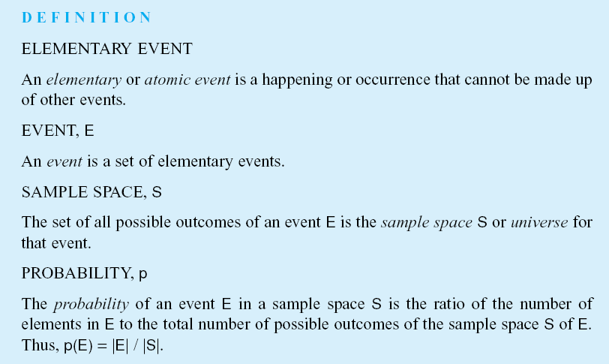

Slide 8



The probability of any event E from the sample space S is:
The sum of the probabilities of all possible outcomes is 1
The probability of the compliment of an event is
The probability of the contradictory or false outcome of an event

Slide 9
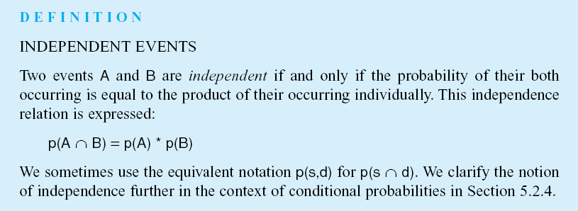
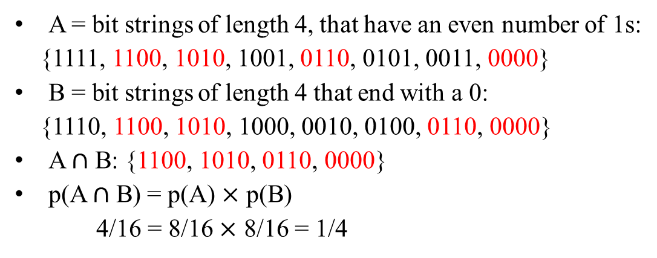
A = bit strings of length 4, that have an even number of 1s:
{1111, 1100, 1010, 1001, 0110, 0101, 0011, 0000}
B = bit strings of length 4 that end with a 0:
{1110, 1100, 1010, 1000, 0010, 0100, 0110, 0000}
A $∩$ B: {1100, 1010, 0110, 0000}
p(A $∩$ B) = p(A) $×$ p(B)
4/16 = 8/16 $×$ 8/16 = 1/4

Slide 10
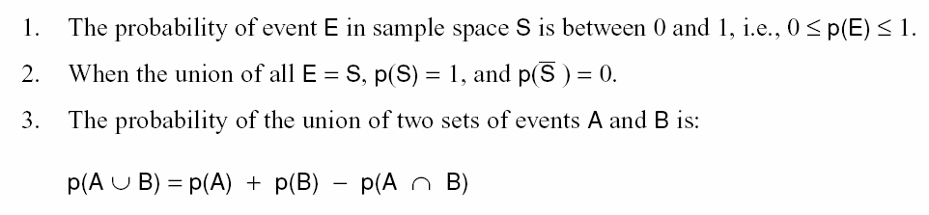
The three Kolmogorov Axioms:
Notes:
Insert lines 3, 4, 5, & 6 pg 174

Slide 11
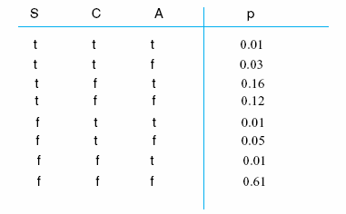
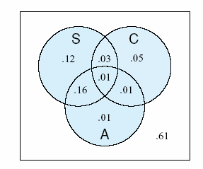
Table 5.1 The joint probability distribution for the traffic slowdown, S, accident, A, and construction, C, variable of the example of Section 5.3.2
Fig 5.1 A Venn diagram representation of the probability distributions of Table 5.1; S is traffic slowdown, A is accident, C is construction.

Slide 12
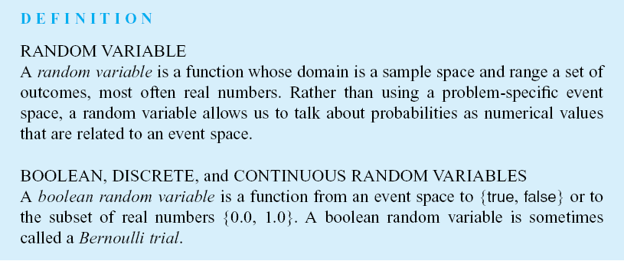
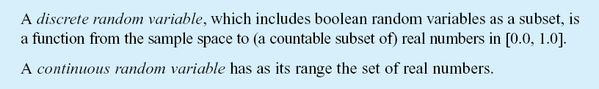

Slide 13
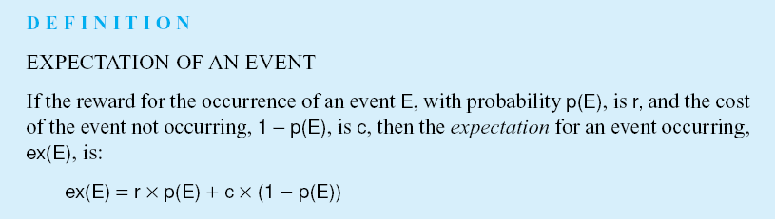

Slide 14
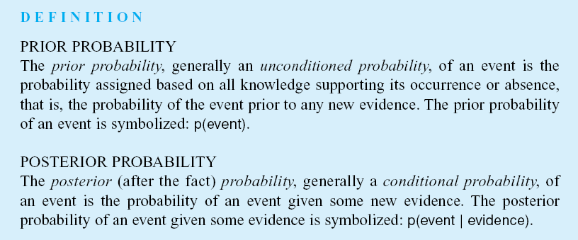

Slide 15
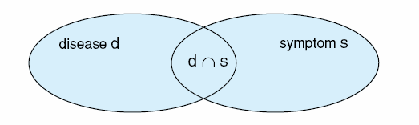



Fig 5.2 A Venn diagram illustrating the calculations of P(d|s) as a function of p(s|d).

Slide 16

The chain rule for two sets:
The generalization of the chain rule to multiple sets
We make an inductive argument to prove the chain rule, consider the n^{th} case:
We apply the intersection of two sets of rules to get:
And then reduce again, considering that:
Until is reached, the base case, which we have already demonstrated.

Slide 17
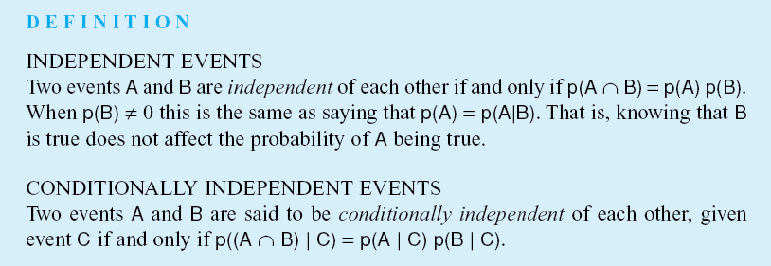

Slide 18
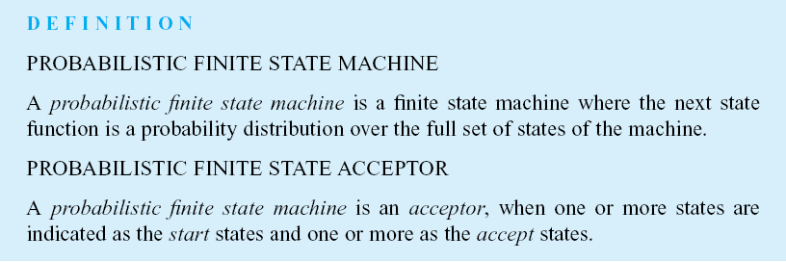

Slide 19
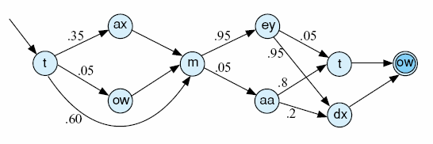
You say [to ow m ey tow] and I say [t ow m aa t ow]…
- Ira Gershwin, Lets Call The Whole Thing Off
Fig 5.3 A probabilistic finite state acceptor for the pronunciation of “tomato”, adapted from Jurafsky and Martin (2000).

Slide 20
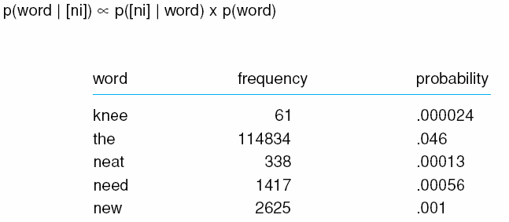
Table 5.2 The ni words with their frequencies and probabilities from the Brown and Switchboard corpora of 2.5M words, adapted from Jurafsky and Martin (2000).

Slide 21
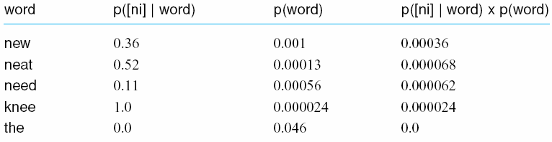
Table 5.3 The ni phone/word probabilities from the Brown and Switchboard corpora (Jurafsky and Martin, 2000).

Slide 22
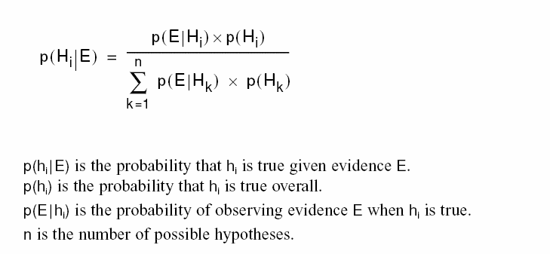
The general form of Bayes’ theorem where we assume the set of hypotheses H partition the evidence set E:

Slide 23
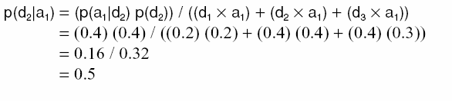
The application of Bayes’ rule to the car purchase problem:
Three dealers
Probability that you will go to dealer 1 (d₁) : 0.2
Probability that you will go to dealer 2 (d₂) : 0.4
Probability that you will go to dealer 3 (d₃) : 0.4
Purchasing probability
At d₁, probability of purchasing a particular automobile, a₁ : 0.2
At d₂, probability of purchasing a particular automobile, a₁ : 0.4
At d₃, probability of purchasing a particular automobile, a₁ : 0.3

Slide 24
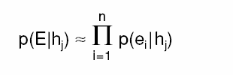
Naïve Bayes, or the Bayes classifier, that uses the partition assumption, even when it is not justified:

Slide 25
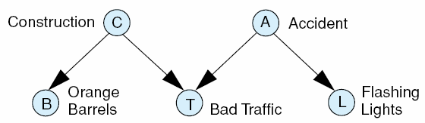
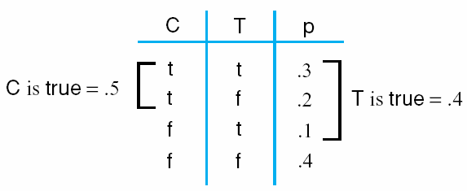
Fig 5.4 The Bayesian representation of the traffic problem with potential explanations.
Table 5.4 The joint probability distribution for the traffic and construction variables of Fig 5.3.

Slide 26
Joint Distribution, An Example
Storm
Bus Tour Group
Lightning
Campfire
Thunder
Forest Fire
P(Storm) P(BusTourGroup) P(Campfire|Storm,BusTourGroup)
P(Lightning|Storm) P(Thunder|Lightning) P(ForestFire|Lightning,Storm,Campfire).
Notes:
What is machine learning?

Slide 27
Learning Belief Networks
We can learn BBN in different ways. Two basic approaches follow:
Assume we know the network structure:
We can estimate the conditional probabilities for each variable
from the data.
Assume we know part of the structure but some variables are missing:
This is like learning hidden units in a neural network.
One can use a gradient ascent method to train the BBN.
Assume nothing is known.
We can learn the structure and conditional probabilities by looking
in the space of possible networks.
Notes:
What is machine learning?

Slide 28
Naïve Bayes
What is the connection between a BBN and classification?
Suppose one of the variables is the target variable. Can we compute the
probability of the target variable given the other variables?
In Naïve Bayes: P(x | a,b) = P(x | a) P(x | b)
assumption: features are conditionally
independent given the category
Concept ω_{j}
x₁
x₂
…
x_{n}
P(x₁, x₂,…, x_{n}, ω_{j}) = P(ω_{j}) P(x₁| ω_{j}) P(x₂ | ω_{j}) … P(x_{n}| ω_{j})
Notes:
What is machine learning?

Slide 29
General Case
In the general case we can use a BBN to specify independence
assumptions among variables.
General Case:
Concept ω_{j}
X1
X2
x4
X3
P(x₁, x₂,…, x_{n}, ω_{j}) = P(ω_{j}) P(x₁| ω_{j}) P(x₂ | ω_{j}) P(x₃ | x₁, x₂, ω_{j}) P(x₄| ω_{j})
Notes:
What is machine learning?

